Slide 1







CAPSTONE PROJECT : HOTEL BOOKING ANALYSIS

Slide 2

OBJECTIVES , ANALYSIS SCOPE AND GOALS OF THE PROJECT
Perform EDA on the given dataset and draw useful conclusions about general trends in hotel bookings
and how factors governing hotel bookings interact with each other.
To create a Power bi report utilizing the Hotel bookings database .The dashboard will help in understanding the analysis of booking details and history, meal and stay details analysis and reservation status analysis among all.

Slide 3
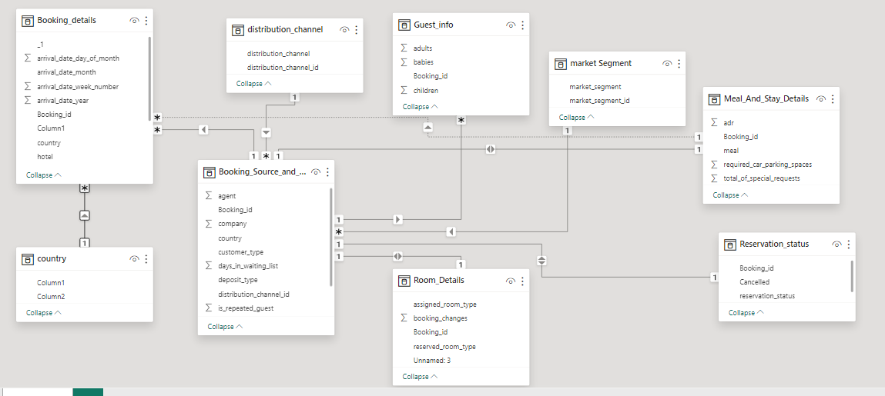
ER DIAGRAM

Slide 4

POWER BI PROBLEM STATEMENTS

Slide 5
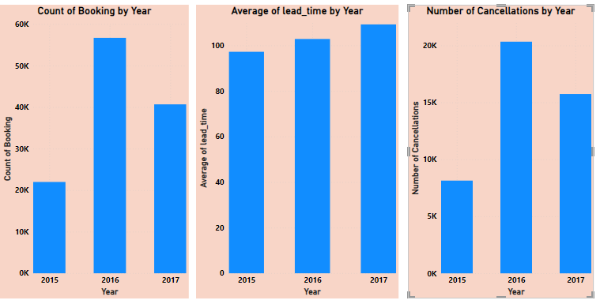
QUES 1: VISUALIZE BOOKING TRENDS OVER THE YEARS, INCLUDING THE NUMBER OF BOOKINGS, CANCELLATIONS, AND AVERAGE LEAD TIME. IDENTIFY SEASONALITY PATTERNS.
CLEARLY CANCELLATION RATE AND BOOKING ARE DIRECTLY PROPORTIONAL. HOWEVER, AVERAGE LEAD TIME IS DIRECTLY PROPORTIONAL TO YEAR SO FOR EACH NEXT YEAR AVERAGE LEAD TIME IS INCREASING.

Slide 6
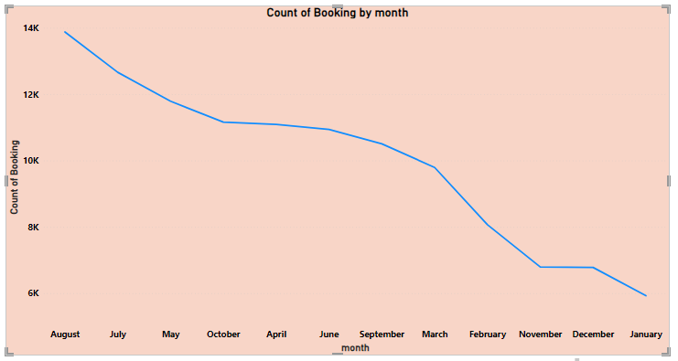
QUES 2. ANALYSE MONTHLY BOOKING PATTERNS TO IDENTIFY PEAK MONTHS AND OPTIMIZE MARKETING STRATEGIES.
AUGUST HAS THE HIGHEST NUMBER OF BOOKINGS WITH COUNT OF 13877.

Slide 7
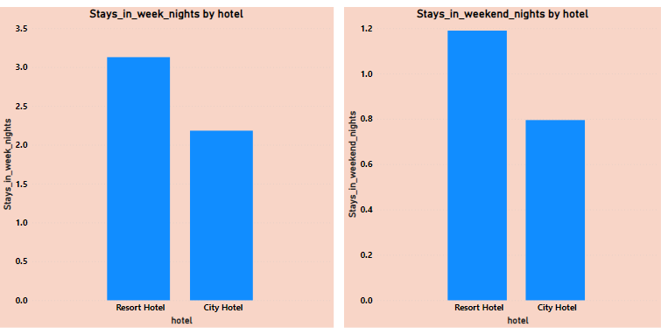
QUES 3. COMPARE STAYS IN WEEKEND NIGHTS AND WEEKDAY NIGHTS TO DETERMINE PREFERENCES AND VARIATIONS BY HOTEL TYPE.
STAYING IN WEEK NIGHTS IS HIGHER THAN STAYING IN WEEKEND NIGHTS FOR BOTH THE HOTELS.

Slide 8
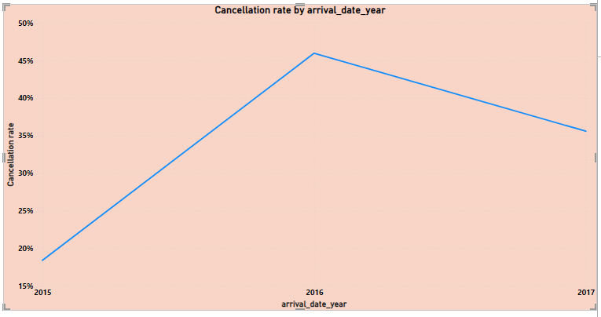
QUES 4. CALCULATE AND VISUALIZE THE BOOKING CONVERSION RATE (CANCELLED BOOKINGS TO TOTAL BOOKINGS) OVER TIME.
.
THE HIGHEST CANCELLATION RATE IS FOR THE YEAR 2016 WITH 45.99% CANCELLATION RATES

Slide 9
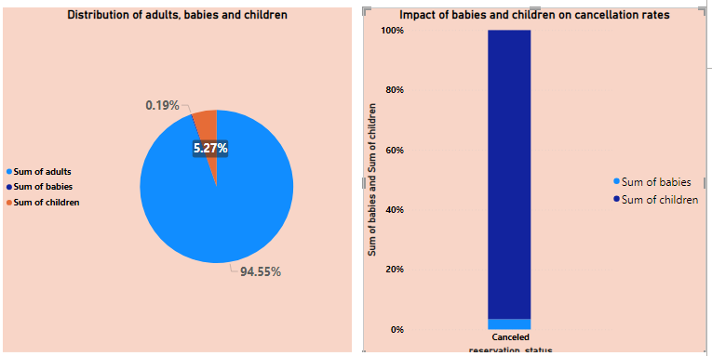
QUES 5. VISUALIZE THE DISTRIBUTION OF ADULTS, CHILDREN, AND BABIES IN BOOKINGS. EXPLORE THE IMPACT OF CHILDREN AND BABIES ON CANCELLATION RATES.
ADULTS HAVE HIGHEST BOOKING COMPARISON TO CHILDREN AND BABIES. CHILDREN HAVE MAJOR IMPACT ON CANCELLATION RATES THAN BABIES.

Slide 10
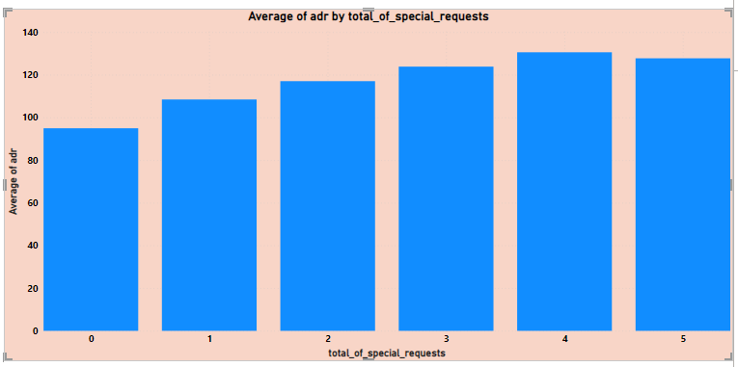
QUES 6. ANALYSE THE DISTRIBUTION OF AVERAGE DAILY RATES (ADR) AND IDENTIFY CORRELATIONS WITH THE NUMBER OF SPECIAL REQUESTS MADE BY GUESTS.
AS THE NUMBER OF SPECIAL REQUESTS INCREASE WE CAN SEE THE INCREASE IN AVERAGE ADR. SO WE CAN SAY THAT SPECIAL REQUESTS IS DIRECTLY PROPORTIONAL TO AVERAGE ADR.

Slide 11
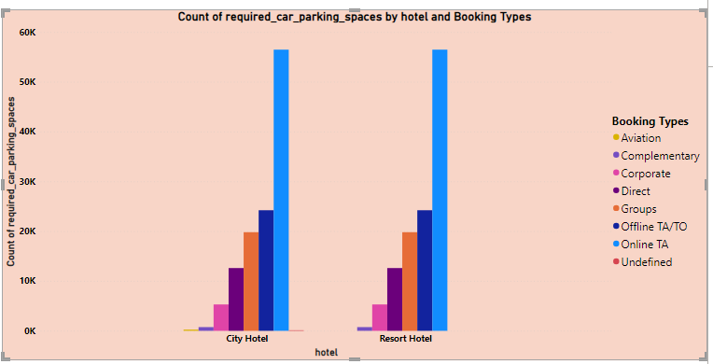
QUES 7. VISUALIZE THE RELATIONSHIP BETWEEN THE NUMBER OF REQUIRED CAR PARKING SPACES AND BOOKING TYPES (RESORT HOTEL VS. CITY HOTEL).
COMPLEMENTARY SEGMENT HAS MAJORITY BOOKINGS FOLLOWED BY DIRECT SEGMENT IN BOTH THE HOTELS.

Slide 12
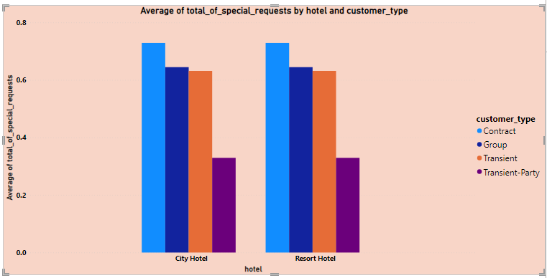
QUES 8. USE POWER BI TO EXPLORE HOW THE TOTAL NUMBER OF SPECIAL REQUESTS MADE BY GUESTS VARIES BY HOTEL TYPE AND CUSTOMER TYPE (E.G., TRANSIENT, GROUP).
FOR BOTH THE HOTEL CONTRACT CUSTOMER TYPES ARE HIGHEST FOR AVERAGE OF SPECIAL REQUESTS.

Slide 13
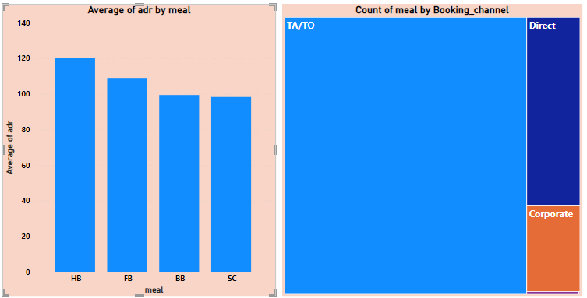
QUES 9. EXPLORE MEAL PLANS AND THEIR IMPACT ON AVERAGE DAILY RATES (ADR). ANALYSE MEAL PLAN PREFERENCES AND THEIR ASSOCIATION WITH BOOKING CHANNELS.
AVERAGE ADR IS MAXIMUM FOR HB CHANNEL WHILE TA/TO CHANNEL HAS HIGHEST MEAL PREFERENCES.

Slide 14
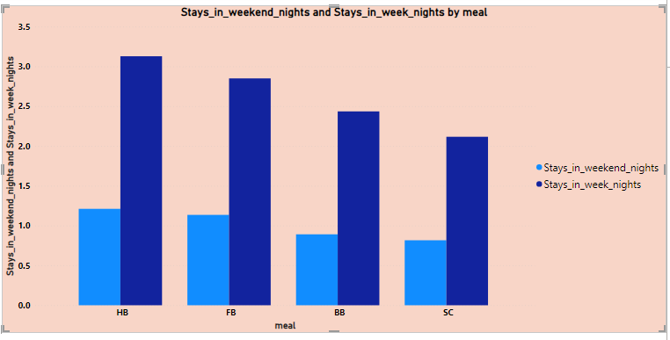
QUES 10. ANALYSE HOW MEAL PLANS CORRELATE WITH STAY DURATION AND INVESTIGATE ANY DIFFERENCES IN STAY LENGTHS BASED ON MEAL PLANS.
STAYING IN WEEK NIGHTS AND STAYING IN WEEKEND NIGHTS BOTH ARE HIGHEST FOR HB MEAL PLANS

Slide 15
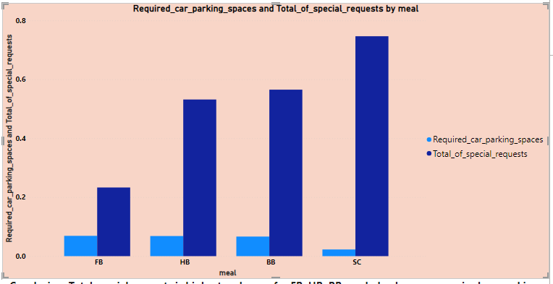
QUES 11. CORRELATE PARKING REQUIREMENTS AND SPECIAL REQUESTS WITH DIFFERENT MEAL PLANS. DETERMINE IF CERTAIN MEAL PLANS RESULT IN MORE REQUESTS OR PARKING NEEDS.
TOTAL SPECIAL REQUESTS IS HIGHEST AND SAME FOR FB, HB, BB MEAL PLAN HOWEVER REQUIRED CAR PARKING SPACE IS HIGHEST FOR SC FOR WHICH SPECIAL REQUEST IS THE LOWEST.

Slide 16
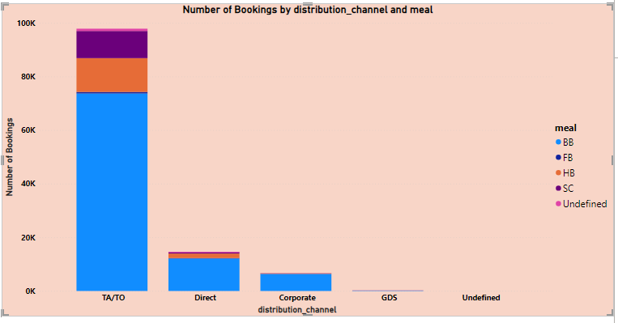
QUES 12. EXPLORE HOW MEAL PLANS ARE DISTRIBUTED ACROSS VARIOUS BOOKING CHANNELS. ANALYSE IF CERTAIN CHANNELS ARE ASSOCIATED WITH SPECIFIC MEAL PLANS.
CLEARLY, BB PLAN IS MORE ASSOCIATED THAN ANY OTHER PLAN IN ALL THE BOOKING SEGMENT

Slide 17
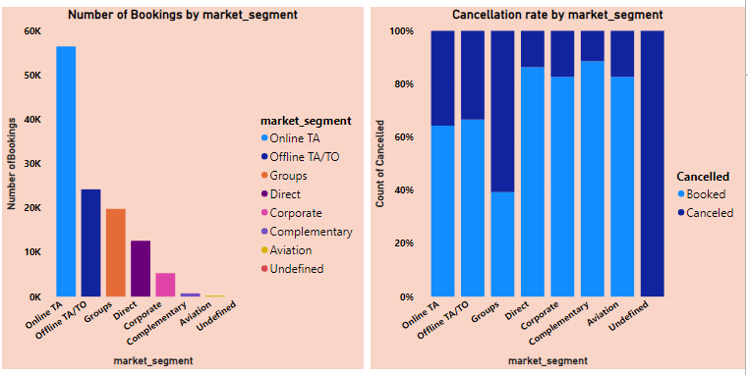
QUES 13. VISUALIZE BOOKING DISTRIBUTION ACROSS DIFFERENT MARKET SEGMENTS AND ANALYSE CANCELLATION RATES WITHIN EACH SEGMENT.
THE NUMBER OF BOOKINGS IS MAXIMUM FOR ONLINE TA MARKET SEGMENT AND CANCELLATION RATE IS HIGHEST FOR GROUPS MARKET SEGMENT WHICH IS 60.69%

Slide 18
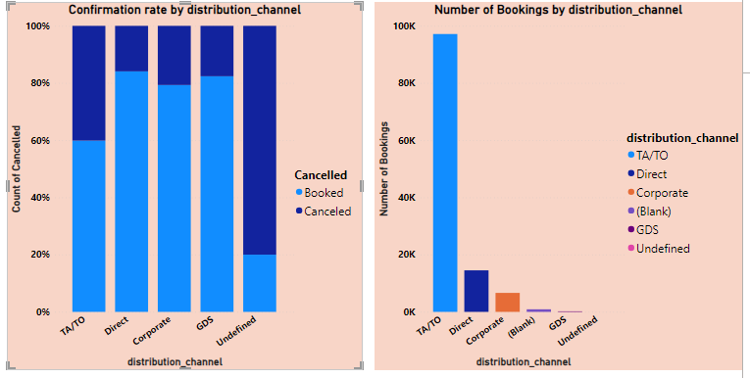
QUES 14. COMPARE THE EFFECTIVENESS OF BOOKING DISTRIBUTION CHANNELS IN GENERATING CONFIRMED BOOKINGS. IDENTIFY THE MOST COMMONLY USED CHANNELS BY GUESTS.
CONFIRMATION RATE IS GOOD FOR DIRECT, CORPORATE AND GDS CHANNEL WHICH IS NEARLY 80%. HOWEVER CONFIRMATION RATE IS ABOVE AVERAGE FOR TA/TO CHANNEL WHICH IS THE HIGHEST IN NUMBER OF BOOKINGS.

Slide 19
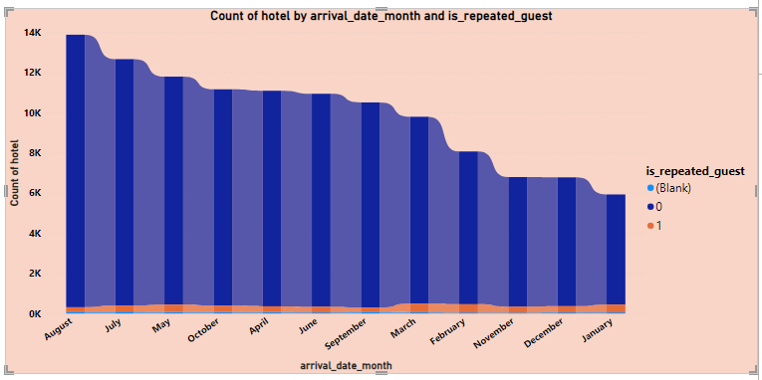
QUES 15. VISUALIZE THE PERCENTAGE OF REPEATED GUESTS FOR EACH HOTEL TYPE (RESORT HOTEL VS. CITY HOTEL) OVER TIME. EXPLORE FACTORS INFLUENCING GUEST RETENTION.
THE NUMBER OF REPEATED GUEST IS MAXIMUM FOR MARCH MONTH WHICH IS 422, ALSO THE RATIO OF REPEATED GUEST TO NON REPEATED GUEST IS VERY LOW I.E. MAJORITY OF GUESTS IN HOTEL ARE NON REPEATED.

Slide 20
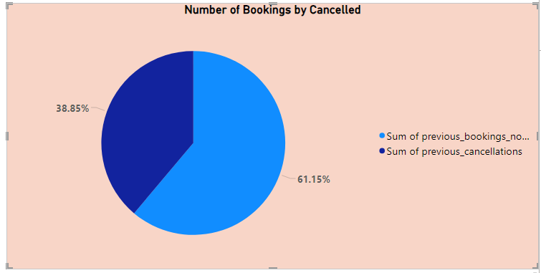
QUES 16. ANALYSE THE IMPACT OF A GUEST'S BOOKING HISTORY (PREVIOUS CANCELLATIONS AND NONCANCELLED BOOKINGS) ON THEIR LIKELIHOOD OF CANCELLING A CURRENT BOOKING.
THE RATIO OF BOOKINGS TO BE CANCELLED IS LOWER THAN NON CANCELLED BOOKINGS. SO, FUTURE BOOKINGS CHANCES TO BE CANCELLED ARE LESS.

Slide 21
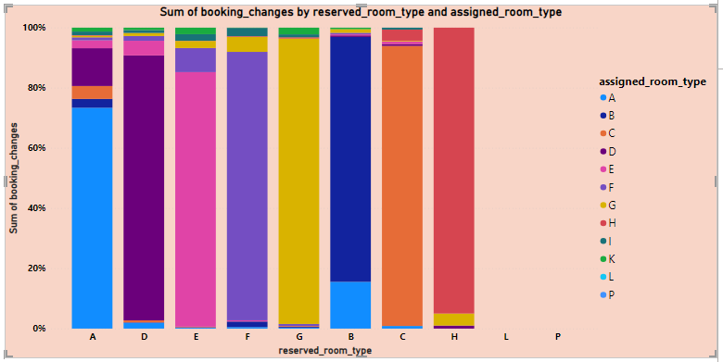
QUES 17. VISUALIZE THE DISTRIBUTION OF RESERVED AND ASSIGNED ROOM TYPES. ANALYSE WHETHER GUESTS TEND TO RECEIVE THE ROOM TYPE THEY INITIALLY RESERVED.
FOR MOST OF THE RESERVED ROOM TYPES THE GUEST HAVE BEEN ASSIGNED THE SAME ROOM HOWEVER THE PERCENTAGE IS HIGHEST FOR H ROOM TYPE WITH 95% AND LOWEST FOR A ROOM TYPE WITH 73.39%

Slide 22
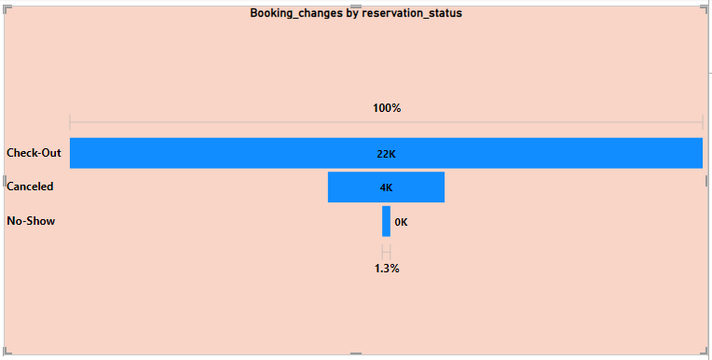
QUES 18. INVESTIGATE THE RELATIONSHIP BETWEEN THE NUMBER OF BOOKING CHANGES MADE BY GUESTS AND THEIR LIKELIHOOD OF CANCELLING A BOOKING.
BOOKING CHANGES ON BEING CANCELED IS 18.45% OF TOTAL CHECKED OUT BOOKING CHANGES. HENCE BOOKING CHANGES HAS SLIGHT INFLUENCE ON RESERVATION BEING CANCELED.

Slide 23
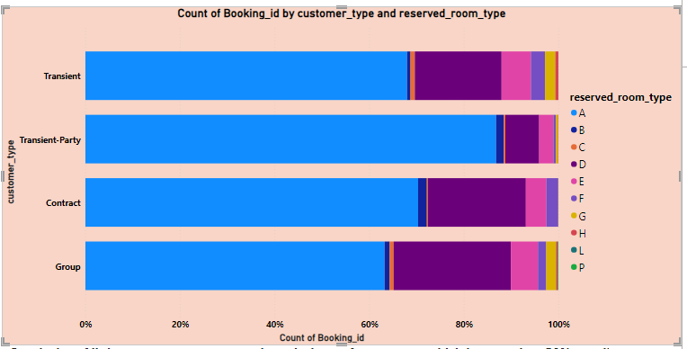
QUES 19. ANALYSE ROOM TYPE PREFERENCES BASED ON CUSTOMER TYPES (E.G., TRANSIENT, GROUP) AND IDENTIFY ANY PATTERNS IN ROOM TYPE SELECTION.
ALL THE CUSTOMER TYPES WANTS IN MAJORITY AN A ROOM TYPE WHICH IS MORE THAN 50% FOR ALL CUSTOMER TYPES.

Slide 24
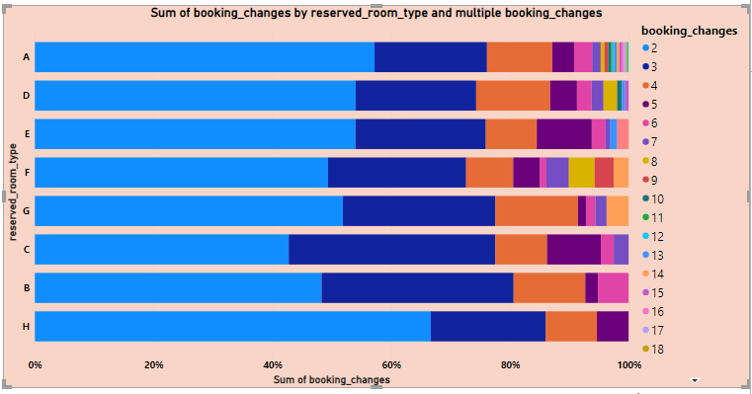
QUES 20. ANALYSE WHETHER GUESTS WHO MAKE MULTIPLE BOOKINGS TEND TO CONSISTENTLY REQUEST THE SAME ROOM TYPE OR IF THEIR PREFERENCES CHANGE OVER TIME.
MULTIPLE BOOKING CHANGES DO AFFECT THE CONSISTENCY OF ROOM TYPE.

Slide 25
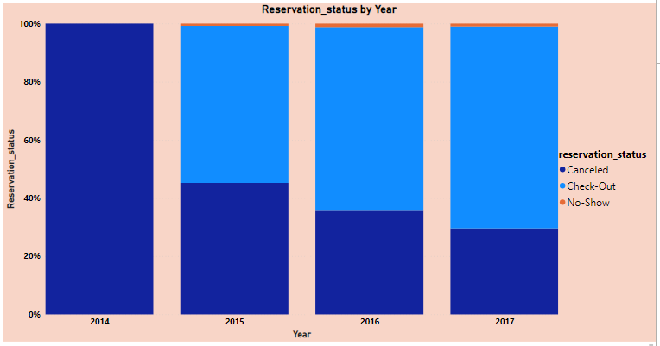
QUES 21. PROVIDE AN OVERVIEW OF RESERVATION STATUSES OVER TIME, INCLUDING THE PERCENTAGE OF CANCELLED, CHECKED OUT, AND NO-SHOW BOOKINGS.
FOR EACH YEAR CANCELLATION RATE IS DECREASING AND CHECK-OUT RATE IS INCREASING.

Slide 26
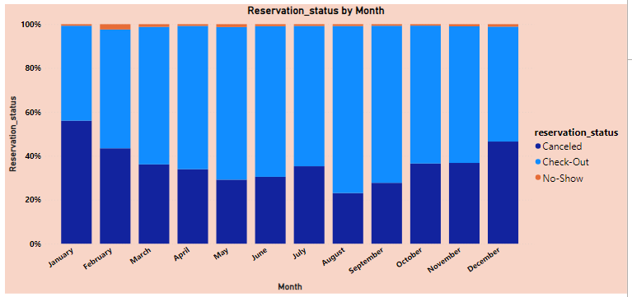
QUES 22. ANALYSE TRENDS IN RESERVATION STATUS DATES, SUCH AS THE BUSIEST CHECKOUT DATES OR PATTERNS IN CANCELLATIONS BY MONTH.
FOR JANUARY MONTH CANCELLATION RATE IS THE HIGHEST WITH 56.04%, FOR FEBRUARY MONTH NO-SHOW RATE IS HIGHEST WITH 2.41% AND CHECK-OUT RATE IS HIGHEST FOR AUGUST MONTH WITH 76.1%.

Slide 27
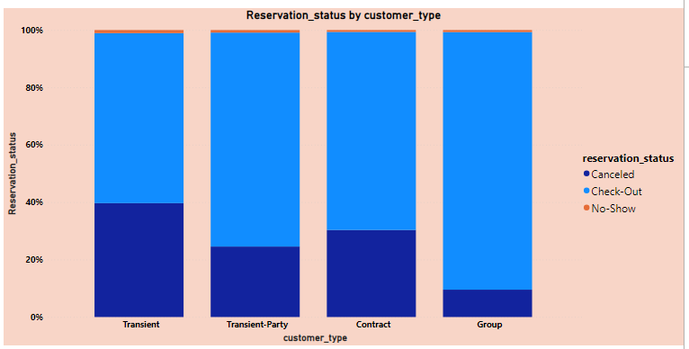
QUES 23. VISUALIZE HOW RESERVATION STATUSES VARY ACROSS DIFFERENT CUSTOMER TYPES (E.G., TRANSIENT, GROUP) AND IDENTIFY IF CERTAIN CUSTOMER TYPES ARE MORE LIKELY TO RESULT IN CANCELLATIONS OR NO-SHOWS
TRANSIENT AND CONTRACT CUSTOMER TYPES ARE MORE LIKELY TO RESULT IN CANCELLATIONS WITH TRANSIENT AS HIGHEST WITH 39.68%. GROUPS ARE THE LEAST LIKELY TO RESULT IN CANCELLATIONS WITH 9.53% OF TOTAL

Slide 28
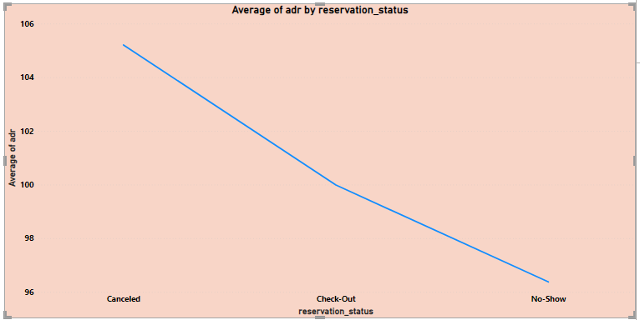
QUES 24. EXPLORE THE RELATIONSHIP BETWEEN RESERVATION STATUSES AND AVERAGE DAILY RATES (ADR) TO DETERMINE IF THERE ARE DIFFERENCES IN ADR BASED ON BOOKING OUTCOMES.
AVERAGE ADR IS HIGHEST FOR CANCELED RESERVATION STATUS AND MINIMUM FOR NO-SHOW RESERVATION STATUS.

Slide 29
EDA PROBLEM STATEMENTS

Slide 30
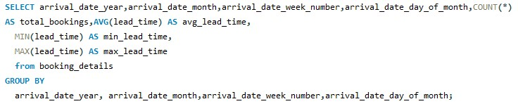
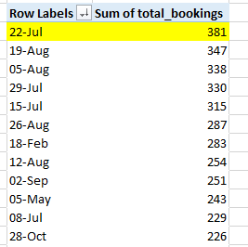
mm
Ques1. Understand the distribution of arrival dates, including the most common arrival days and summary statistics for lead times.
Conclusion:22 July is the most common arrival day

Slide 31
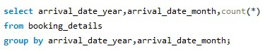
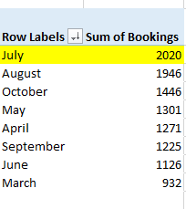
mm
Ques 2. Identify peak booking months and analyze reasons for spikes in bookings, including holidays or events.
Conclusion : July is the peak booking months with a total of 2020 bookings

Slide 32
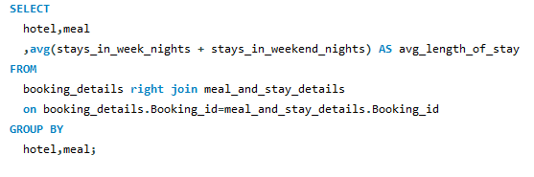
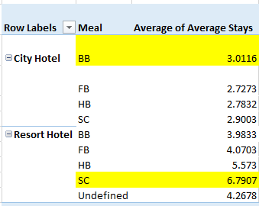
mm
Ques 3. Calculate the average length of stays for different hotel types and explore variations by meal plans.
Conclusion: For City Hotel BB meals is preferred for highest average stays while for Resort Hotel SC is preferred.

Slide 33
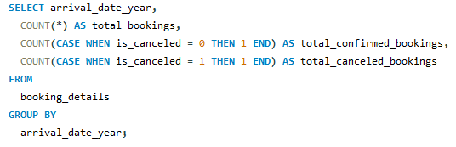
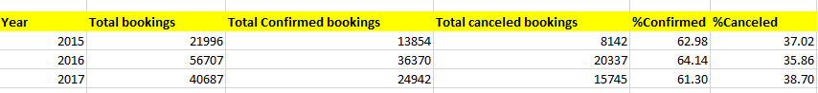
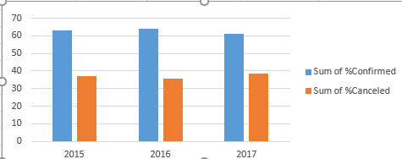
mm
Ques 4. Analyze how booking patterns have evolved over the years, including year over year changes in bookings and cancellations.
Conclusion: Clearly year 2016 has highest Confirmed Bookings while Year 2017 has highest canceled bookings

Slide 34
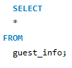
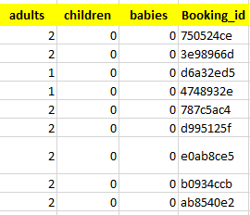
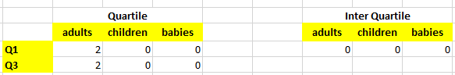
mm
Ques 5. Understand the distribution of the number of adults, children, and babies and identify any outliers.
Conclusion: From Inter Quartile range we can conclude that there are nearly no outliers in our data.

Slide 35
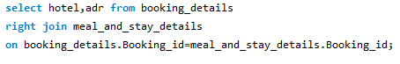
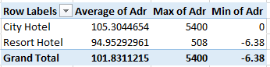
mm
Ques 6. Calculate summary statistics for ADR and explore differences between Resort Hotel and City Hotel bookings.
Conclusion : Clearly Adr rates in City Hotel is higher as compare to Resort Hotel

Slide 36
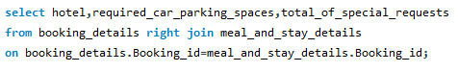
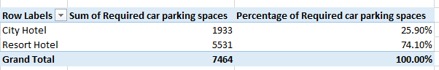
mm
Ques 7. Analyze the distribution of required car parking spaces for each hotel type and determine if one type attracts more guests with cars.
Conclusion: The Resort Hotel type attracts more guests as compare to City hotel

Slide 37
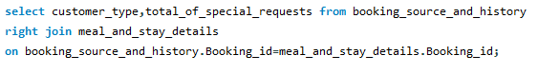
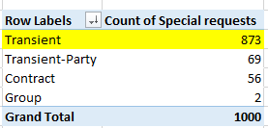
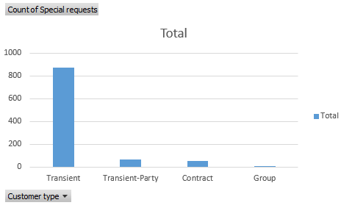
mm
Ques 8. Compare the total number of special requests made by different customer types (e.g., Transient, Group) and identify which customer type makes more requests.
Conclusion : transient type has maximum special requests

Slide 38
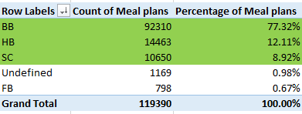
mm
Ques 9. Understand the distribution of meal plans (e.g., BB, HB, FB, SC) and identify any patterns or preferences.
Conclusion : From the above dataset clearly BB plan has highest preferences followed by HB and then SC. Fb has least preference.

Slide 39
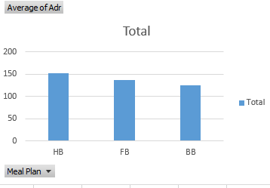
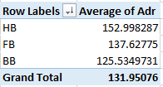
mm
Ques 10. Analyze Average Daily Rates (ADR) by meal plan type to identify variations in pricing.
Conclusion: Clearly, HB has highest average adr and FB and BB have less variation as compare to price variation of HB,

Slide 40
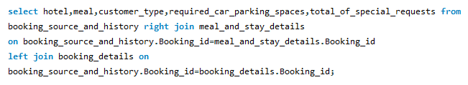
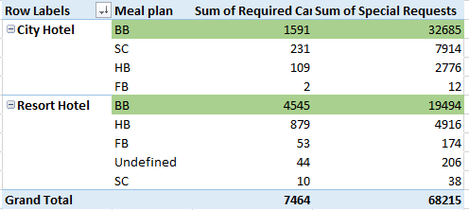
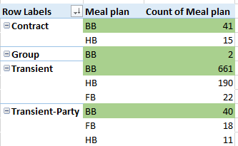
mm
Ques 11. Investigate the distribution of required car parking spaces and special requests by hotel type and meal plan. 12 .Compare the distribution of meal plans among different customer types (e.g., Transient, Group) to identify preferences.
Conclusion: From Required car parking spaces to special requests to customer type meal plans each has highest preference of BB meal plan.

Slide 41


mm
Ques 12. Understand the distribution of bookings across different market segments and calculate summary statistics for lead times within each segment.
Conclusion : Clearly, Offline TA/TO market segment has highest average lead time in Groups, Direct, Online TA it is same it is very less in Corporate.

Slide 42


mm
Ques 13 .Analyze the distribution of bookings through different booking channels (e.g., online travel agents, direct bookings) and calculate the percentage of bookings through each channel.
Conclusion : TA/TO acquires maximum percentage of bookings about 78.80% and corporate nearly negligible with 1.20%

Slide 43


mm
Ques 14. Calculate the proportion of repeated guests and investigate their booking behavior. Identify any patterns or differences in preferences compared to first-time guests.
Conclusion: Since repeated guests all datasets are zero hence nothing can be said about booking behavior.

Slide 44


mm
Ques 15. Explore the impact of a guest's booking history on their likelihood of canceling a current booking. Calculate cancellation rates based on previous cancellations and noncancelled bookings.
Conclusion: Since Cancelled and non cancelled bookings have no entry except zero hence no conclusions can be made.

Slide 45




mm
Ques 16.Understand the distribution of reserved and assigned room types. Calculate summary statistics for the consistency between reserved and assigned room types.
Conclusion: Clearly, in both charts top three types are same hence there is consistency in top room type but the bottom types are changed hence inconsistency in room type is also present.

Slide 46


mm
Ques 17. Analyze the impact of booking changes on cancellation rates. Calculate cancellation rates for bookings with different numbers of changes.
Conclusion: There is a small impact on booking changes for cancellation rate which is 12.24%

Slide 47


mm
Ques 18. Explore how room type preferences vary across different customer types (e.g., Transient, Group). Identify if certain customer types have specific room preferences.
Conclusion: All Customer types have highest preference of A room type.

Slide 48



mm
Ques 19. Examine whether guests who make multiple bookings have consistent room type preferences or if their preferences change over time.
Conclusion: A,D,E room type has highest number of repeated guests in the respective order in both reserved and assigned room type.

Slide 49

mm
Ques 20. Understand the distribution of reservation statuses and calculate summary statistics for reservation status dates.
Conclusion: Check-Out has highest reservation status with 17 july as highest reserve date for canceled it is 29 Jun and for no show it is 17 July.

Slide 50


mm
Ques 21. Analyze trends in reservation status dates, including the most common checkout dates and any seasonality patterns.
Conclusion: The most checkout date is 17 July.

Slide 51


mm
Ques 22. Explore how reservation statuses vary across different customer types (e.g., Transient, Group) using Excel or SQL. Calculate cancellation rates by customer type.
Conclusion: Transient Customer type has Highest reservation status and cancellation rate is 31.60%.

Slide 52


mm
Ques 23. Investigate whether there are differences in Average Daily Rates (ADR) based on reservation status (e.g., canceled vs. checked out).
Conclusion: There is not much difference in Average adr of Check-Out and No-show but large difference between Check-Out and Canceled Adr and No-show and canceled adr.

Slide 53
Thank you

